Slide 1
Energy and Climate Modeling Methods and Tools
Görkem Güngör
E-mail: ggungor@enerji.gov.tr

Slide 2
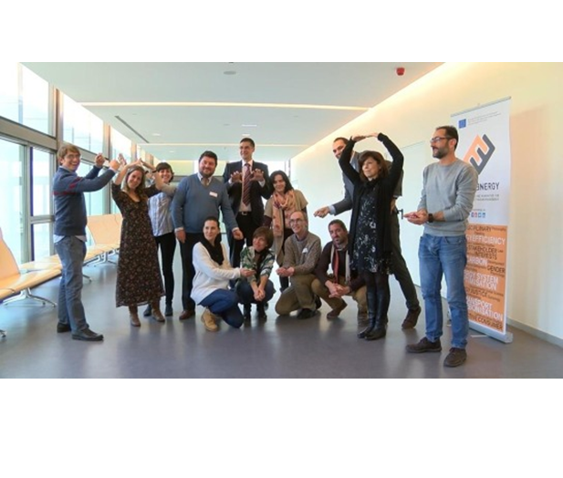
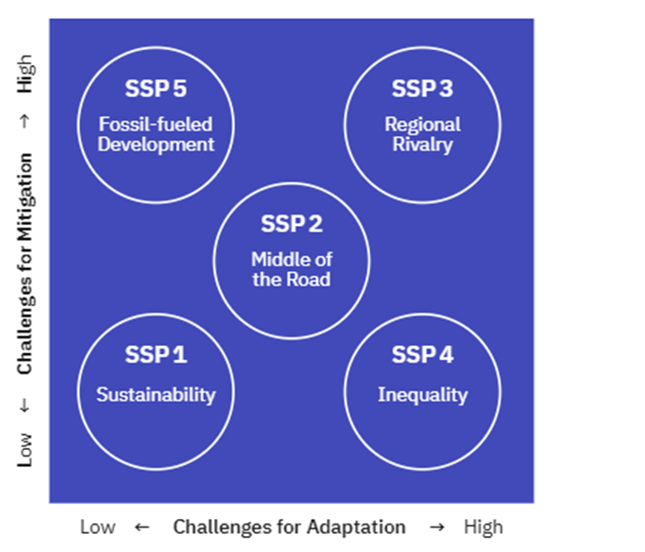
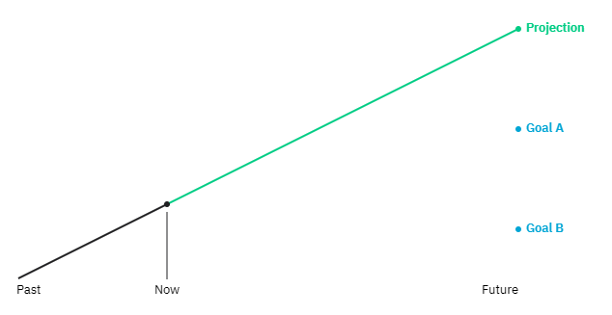
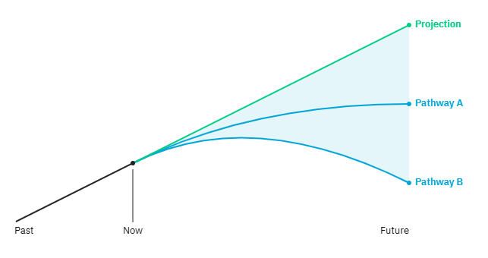
Climate Scenarios
Explore possible futures with the assumptions they depend upon and the courses of action that could make them happen
"What can happen?" vs. "What should happen?"
"Baseline" with no policy intervention vs. "Pathway" with climate policy integration
Storytelling allowing personal bias and multi-stakeholder engagement can be effective for comprehensive scenario development
Notes:
https://climatescenarios.org/primer/
Mourik, R. M., Sonetti, G., & Robison, R. A. V. (2021). The same old story – or not? How storytelling can support inclusive local energy policy. Energy Research & Social Science, 73(November 2020), 101940. https://doi.org/10.1016/j.erss.2021.101940

Slide 3
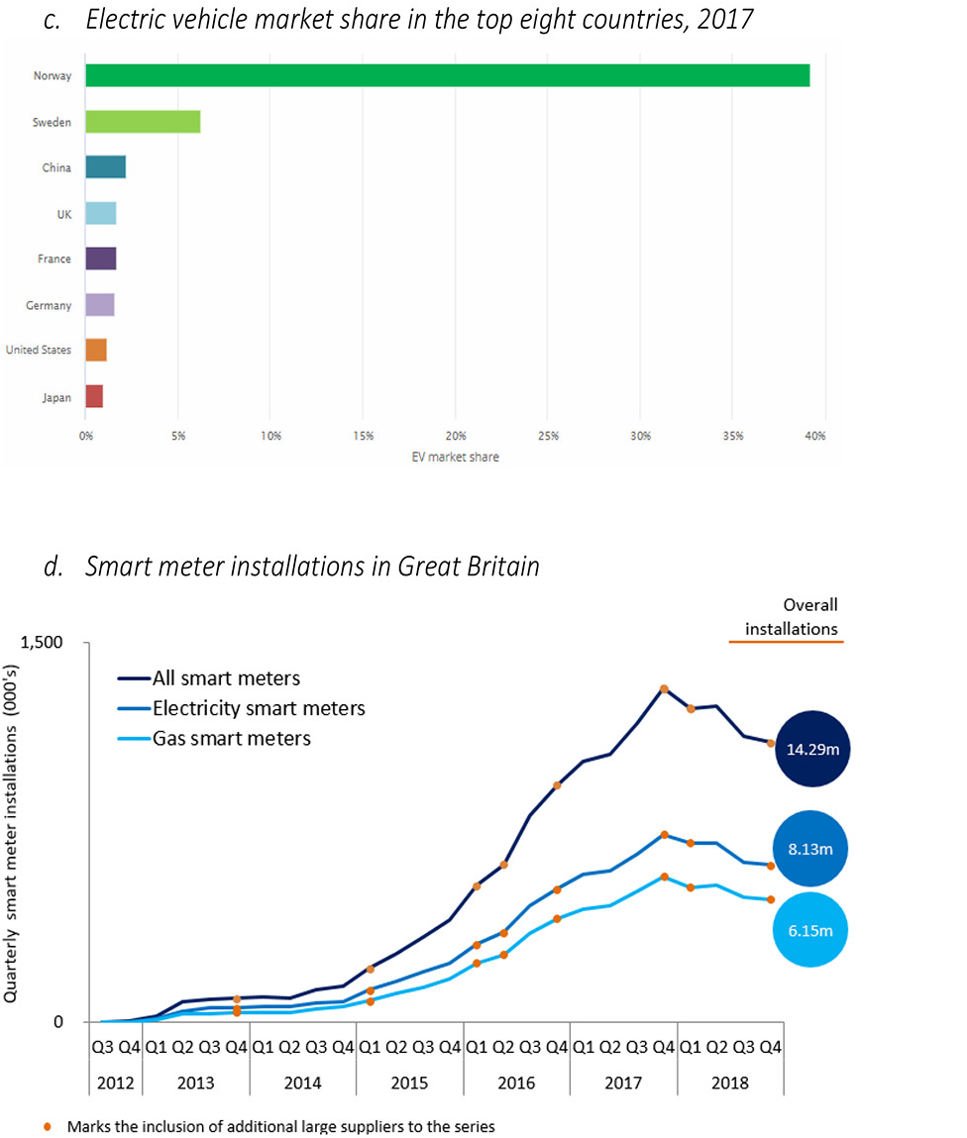
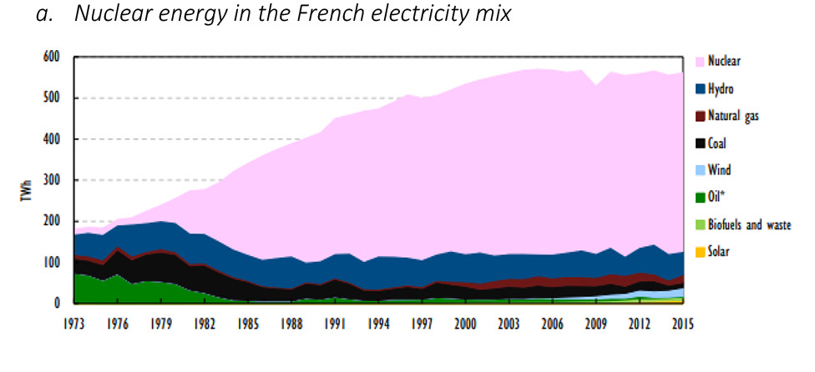
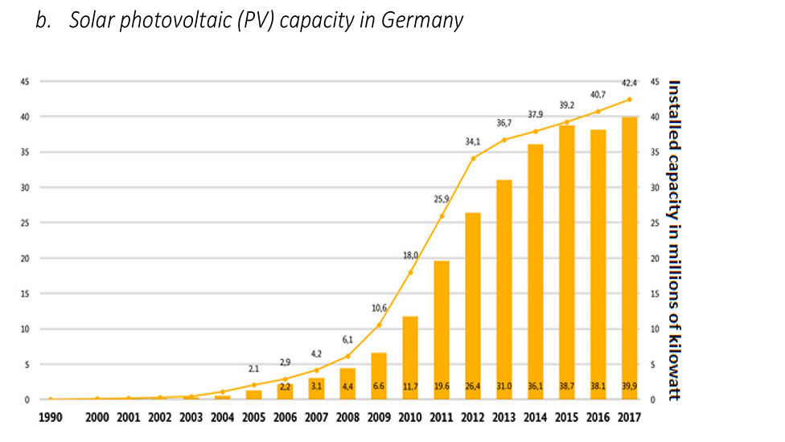
Choice experiments
Choice experiments (contingent evaluation method) are used for evaluating impacts of policies againts preferences of end users
There may be social barriers against energy efficiency investments (preferences, habits)
Conflicting objectives of end users might create bias in responses
Combination of multiple methods (semi-structured interview, focus groups, online forums) might reduce this bias
Notes:
Sovacool, B. K., Martiskainen, M., Hook, A., & Baker, L. (2020). Beyond cost and carbon: The multidimensional co-benefits of low carbon transitions in Europe. Ecological Economics, 169(August 2019), 106529. https://doi.org/10.1016/j.ecolecon.2019.106529

Slide 4
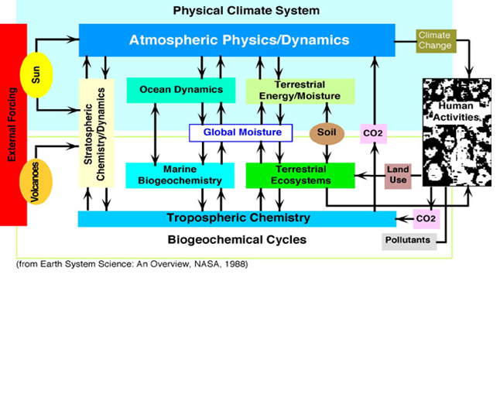
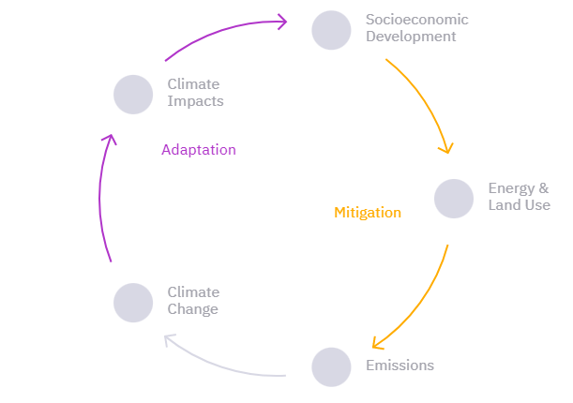
Climate Change and the Earth System
Socioeconomic scenarios describe the development of societal drivers
Emissions, concentration and climate forcing emerge from these scenarios
Climate change scenarios result from climate forcing
Climate impact scenarios result from climate change
Mitigation scenarios describe actions to reduce climate forcing
Adaptation scenarios describe actions to limit the impacts of climate change
Integrated scenarios describe climate forcings with feedback loops

Slide 5
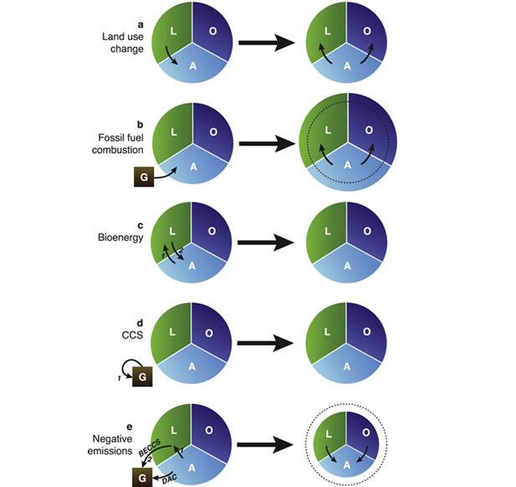
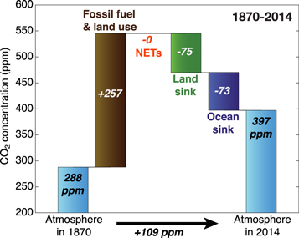
Earth System Feedbacks
Land and oceans are carbon sinks but their potential decreases with climate change
Net-zero carbon emission scenarios require negative emission technologies
However, Earth System Models lack some important processes:
Role of nutrient cycles (N and P)
Burning of old land carbon stocks (peat fires)
Release of carbon from thawing permafrost
Notes:
Jones, C. D., Ciais, P., Davis, S. J., Friedlingstein, P., Gasser, T., Peters, G. P., Rogelj, J., van Vuuren, D. P., Canadell, J. G., Cowie, A., Jackson, R. B., Jonas, M., Kriegler, E., Littleton, E., Lowe, J. A., Milne, J., Shrestha, G., Smith, P., Torvanger, A., & Wiltshire, A. (2016). Simulating the Earth system response to negative emissions. Environmental Research Letters, 11(9), 095012. https://doi.org/10.1088/1748-9326/11/9/095012

Slide 6
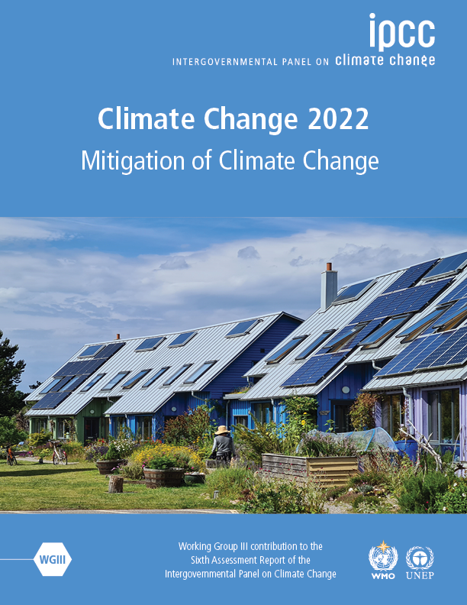
Climate Change Scenarios
Scenarios in IPCC AR6 have been expanded to include energy, emissions and sectoral scenarios from global to national scales
Scenario ensemble contains
3131 quantitative scenarios derived from
188 unique modelling frameworks and 95+ model families that are comprehensive for global, national, multi-regional or sectoral policies
Notes:
https://data.ene.iiasa.ac.at/ar6/#/about

Slide 7
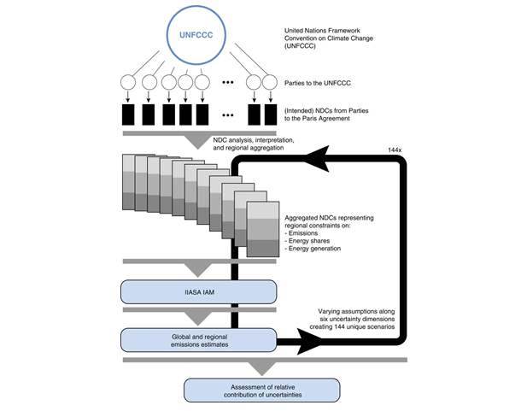
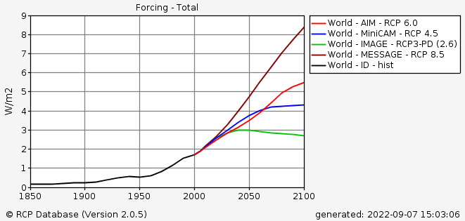
Reference Concentration Pathways
Carbon emission constraints are expressed relative to either
National emission reference emission trajectories or
National historic emission levels
Uncertainties can be reduced by scenario analysis and technical clarifications in energy accounting methods
Other uncertainties are harder to reduce as they are the result of political choices
Notes:
https://tntcat.iiasa.ac.at/RcpDb/dsd?Action=htmlpage&page=compare
Rogelj, J., Fricko, O., Meinshausen, M., Krey, V., Zilliacus, J. J. J., & Riahi, K. (2017). Understanding the origin of Paris Agreement emission uncertainties. Nature Communications, 8(1), 15748. https://doi.org/10.1038/ncomms15748

Slide 8
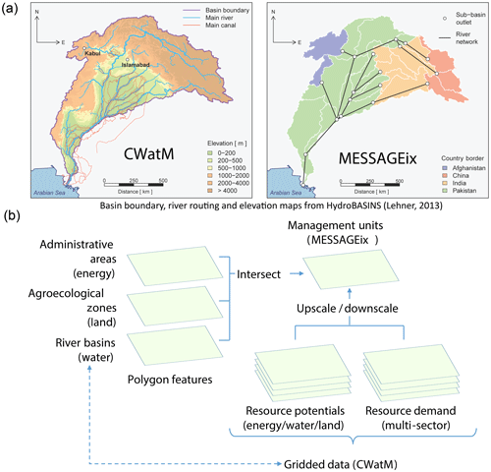
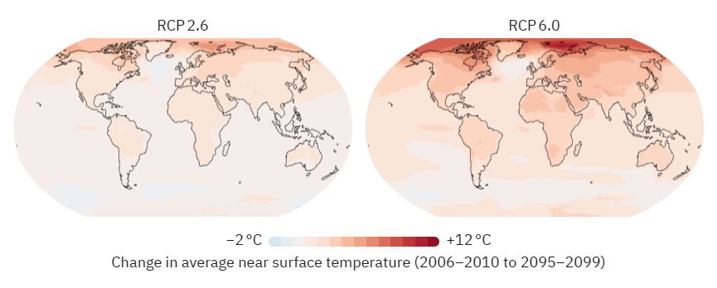
Climate Change Impacts
Target | Description | Modeling: SDG vs. baseline
Water sector development scenarios
Sustainable water withdrawals | SDG 6.6: by 2020, protect and restore water-related ecosystems, including mountains, forests, wetlands, rivers, aquifers and lakes | Minimum of 20 % of monthly natural flow left in rivers and aquifers by 2030. Set sustainable levels of groundwater extractions (also in baseline)
Wastewater treatment | SDG 6.3: by 2030, improve water quality by reducing pollution, halving the proportion of untreated wastewater and substantially increasing recycling and safe reuse globally | Treat half of return flows treated by 2030; recycle one-quarter of return flows. Baseline: no targets
Target | Description | Modeling: SDG vs. baseline
Climate action
Global greenhouse gas (GHG) emissions | SDG 13.a: implement the commitment undertaken by to the United Nations Framework Convention on Climate Change | Set GHG emission budget and climate scenario accordingly. Baseline: no emission targets
Clean and affordable energy development scenarios
Clean energy access | SDG 7.2: by 2030, 50 % share of renewable energy in the global energy mix | Set targets on share of renewables (wind, solar, geothermal). Baseline: no targets
Power plant cooling | SDG 7.b: by 2030, expand infrastructure and upgrade technology for supplying modern and sustainable energy services for all | Phase out of once-through cooling, imposing capacity constraint. Baseline: no targets
Sustainable agriculture scenarios
Food and agriculture infrastructure access | SDG 2.4: by 2030, 100 % implementation of modern so-called smart irrigation technologies that increase productivity and production relative to 2015 | SDG 2.4: constrain technologies with low efficiency to have zero capacity in 2030. Baseline: no smart irrigation technologies adopted before 2030
Climate impacts are consequences and effects of climate change on nature and society such as:
Changed agricultural yields
Increased floods and droughts
Coral reef bleaching
Requires the integrated usage of hydrological models with resource supply planning models
Identify the synergies and trade-offs for SDGs between countries and regions
Notes:
https://climatescenarios.org/primer/climate-impacts
Vinca, A., Parkinson, S., Byers, E., Burek, P., Khan, Z., Krey, V., Diuana, F. A., Wang, Y., Ilyas, A., Köberle, A. C., Staffell, I., Pfenninger, S., Muhammad, A., Rowe, A., Schaeffer, R., Rao, N. D., Wada, Y., Djilali, N., & Riahi, K. (2020). The NExus Solutions Tool (NEST) v1.0: an open platform for optimizing multi-scale energy–water–land system transformations. Geoscientific Model Development, 13(3), 1095–1121. https://doi.org/10.5194/gmd-13-1095-2020

Slide 9
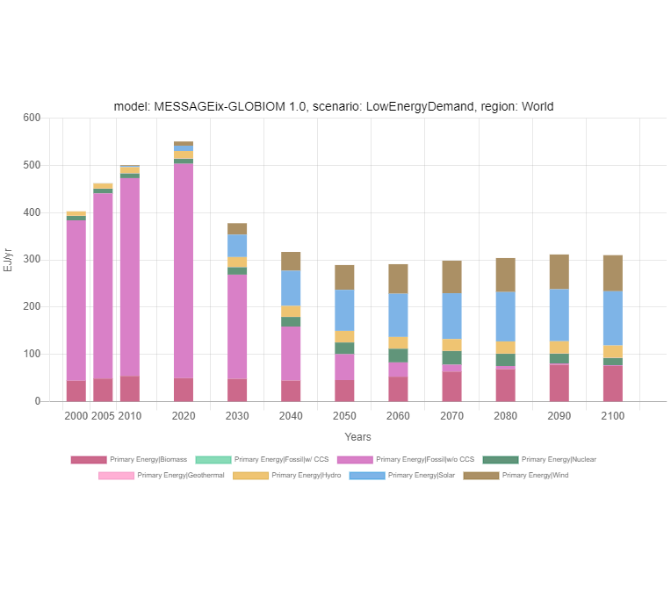
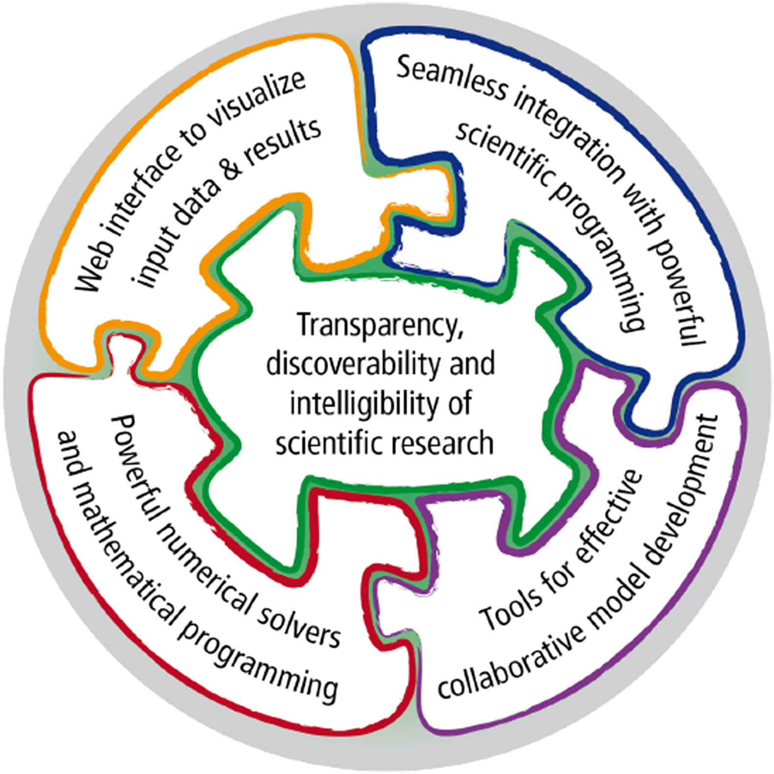
Transition in Modelling Practices
Scientists communicate in the policy arena using their modelling results
Sectoral and regional interconnected networks resulted in paradigm shifts:
Increasing complexity that requires social sciences besides the techno-economical aspects
Nexus issues and interaction accross sectors with more detailed spatial and temporal resolution
Transparency, reproducibility and intelligibility with the development of open-source software and tools
Notes:
https://manager.ece.iiasa.ac.at/services/overview/public
Huppmann, D., Gidden, M., Fricko, O., Kolp, P., Orthofer, C., Pimmer, M., Kushin, N., Vinca, A., Mastrucci, A., Riahi, K., & Krey, V. (2019). The MESSAGEix Integrated Assessment Model and the ix modeling platform (ixmp): An open framework for integrated and cross-cutting analysis of energy, climate, the environment, and sustainable development. Environmental Modelling & Software, 112(March 2018), 143–156. https://doi.org/https://doi.org/10.1016/j.envsoft.2018.11.012

Slide 10

Energy Behavior
Climate policy making has been influenced more by physical sciences with current efforts for balancing with social sciences and humanities
Research agendas include
The identification and characterization of subjective information,
Understanding and improving public perception,and
Clarifying and evaluating possible action options
Notes:
https://www.apa.org/science/about/publications/climate-crisis-action-plan.pdf
Fischhoff, B. (2020). Making behavioral science integral to climate science and action. Behavioural Public Policy, 1–15. https://doi.org/10.1017/bpp.2020.38

Slide 11
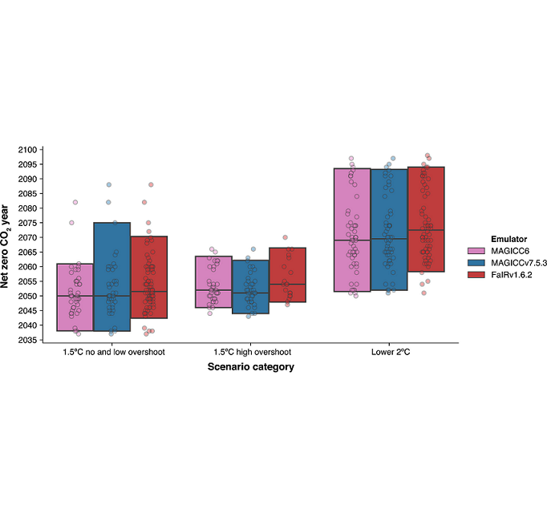
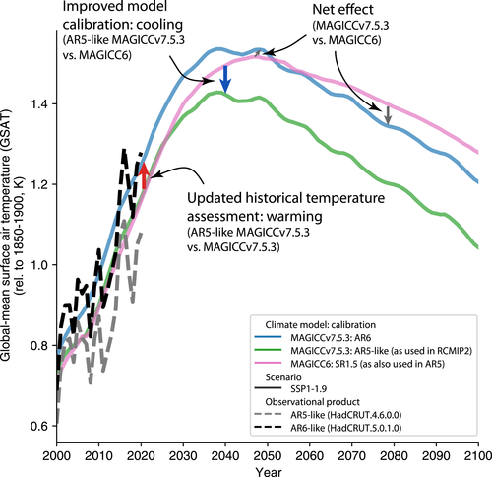
Climate Modeling
The underlying factors in the IPCC reports can change in time depending on current state of science
Increase in historical emissions used for climate modeling are compensated by short-term warming response to carbon emissions
The peak warming projections in SR1.5 and AR6 are consistent despite the usage of different "earth system emulators"
Notes:
Nicholls, Z., Meinshausen, M., Lewis, J., Smith, C. J., Forster, P. M., Fuglestvedt, J. S., Rogelj, J., Kikstra, J. S., Riahi, K., & Byers, E. (2022). Changes in IPCC Scenario Assessment Emulators Between SR1.5 and AR6 Unraveled. Geophysical Research Letters, 49(20), 1–11. https://doi.org/10.1029/2022GL099788

Slide 12
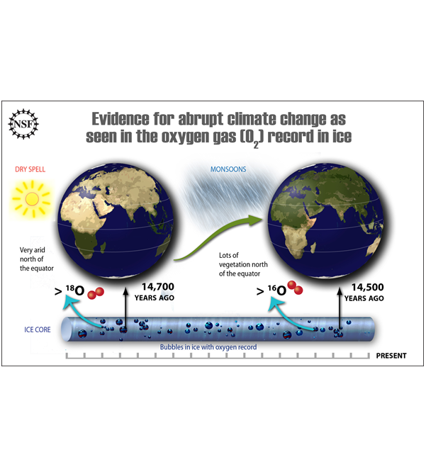
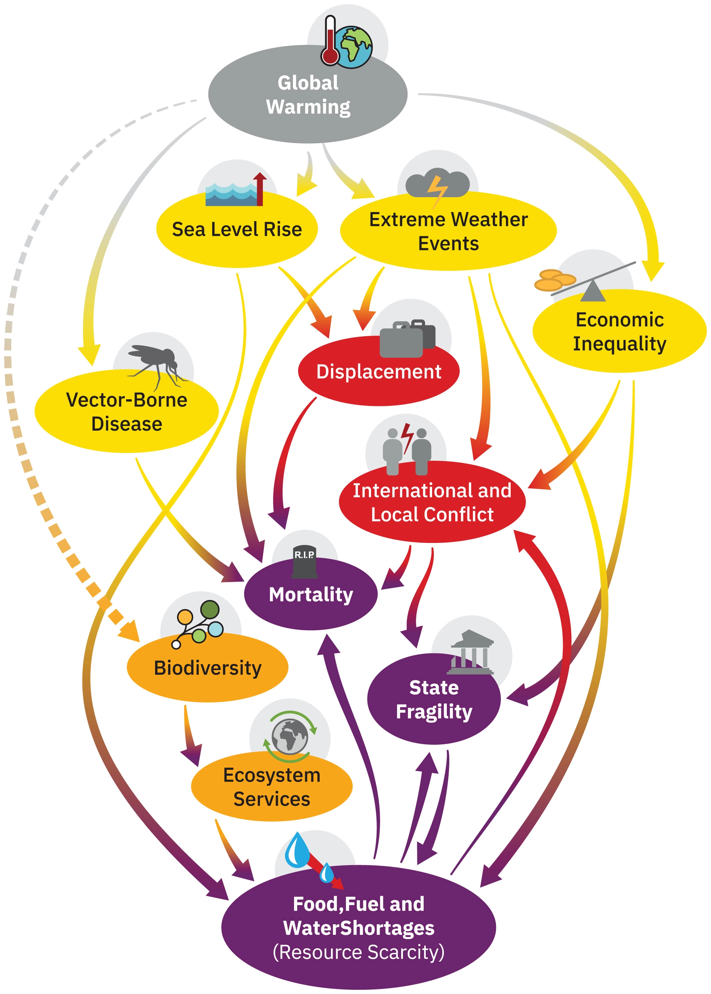
Climate Extreme Events
What is the potential for climate change to drive mass extinction events?
What are the mechanisms that could result in human mass mortality andmorbidity?
What are human societies' vulnerabilities to climate- triggered risk cascades, such as from conflict, political insta- bility, and systemic financial risk?
How can these multiple strands of evidence - together with other global dangers - be usefully synthesized into an “integrated catastrophe assessment”?
Notes:
Kemp, L., Xu, C., Depledge, J., Ebi, K. L., Gibbins, G., Kohler, T. A., Rockström, J., Scheffer, M., Schellnhuber, H. J., Steffen, W., & Lenton, T. M. (2022). Climate Endgame: Exploring catastrophic climate change scenarios. Proceedings of the National Academy of Sciences, 119(34), 1–9. https://doi.org/10.1073/pnas.2108146119
https://www.science.org/doi/10.1126/science.1169473

Slide 13
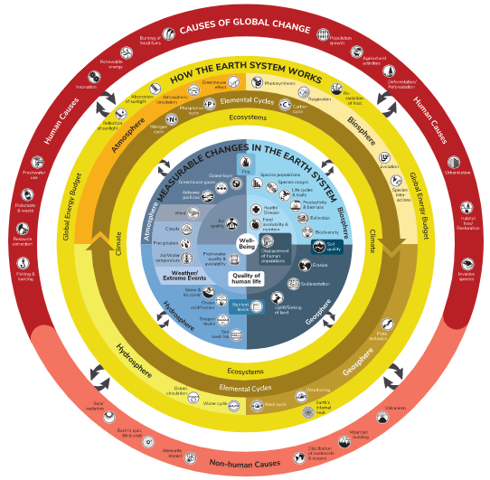
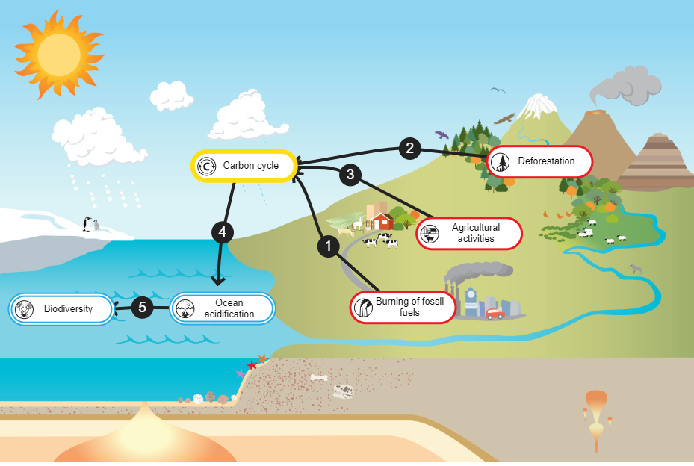
Earth System Modeling
Humans burn hydrocarbons, that are buried deep in the Earth
Deforestation removes the carbon reservoirs
Clearing land with fire for converting to agriculture and degradation of soil under intensive agriculture
The atmospheric concentration of carbon dioxide increases, which is also dissolved in the ocean, making the ocean become more acidic
A more acidic ocean makes it harder to precipitate calcium carbonate from seawater for marine species
Ocean Acidification
Notes:
https://www.biointeractive.org/classroom-resources/understanding-global-change

Slide 14
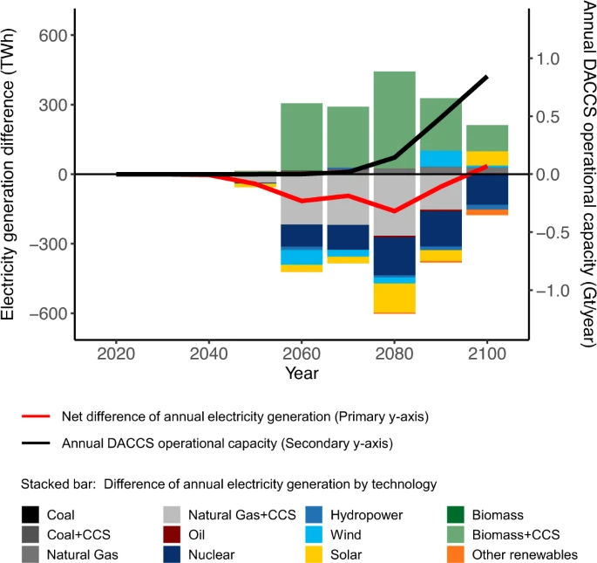
Net-zero Carbon Emissions
Electricity sector decarbonization and direct air carbon capture and storage (DACCS) technology improvements are for the net-zero carbon emissions target
The environmental and climate performance of DACCS depends on sectoral mitigation actions
Additional efforts are needed to facilitate sustainable mining, manufacturing, and expanding the circular economy of energy materials
Notes:
Qiu, Y., Lamers, P., Daioglou, V., McQueen, N., de Boer, H.-S., Harmsen, M., Wilcox, J., Bardow, A., & Suh, S. (2022). Environmental trade-offs of direct air capture technologies in climate change mitigation toward 2100. Nature Communications, 13(1), 3635. https://doi.org/10.1038/s41467-022-31146-1

Slide 15
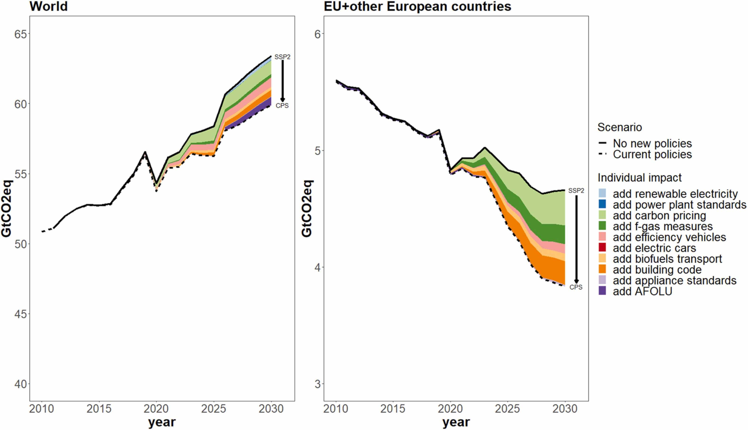
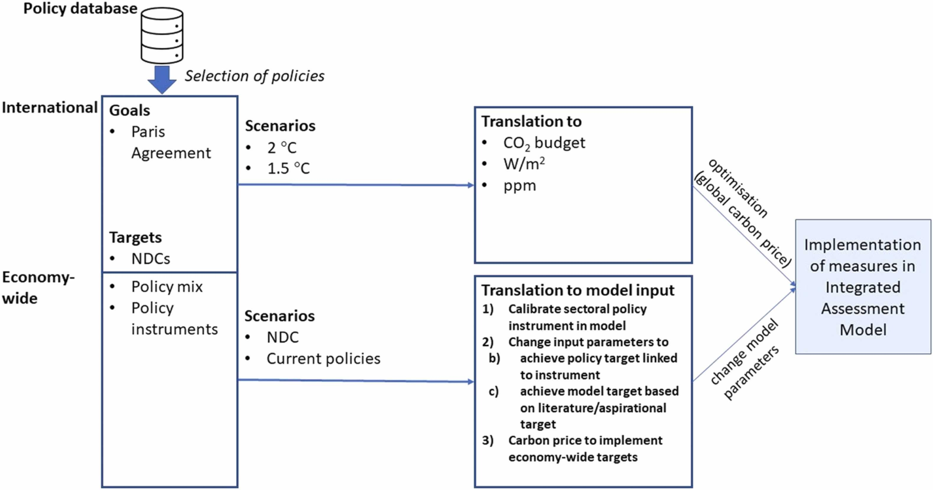
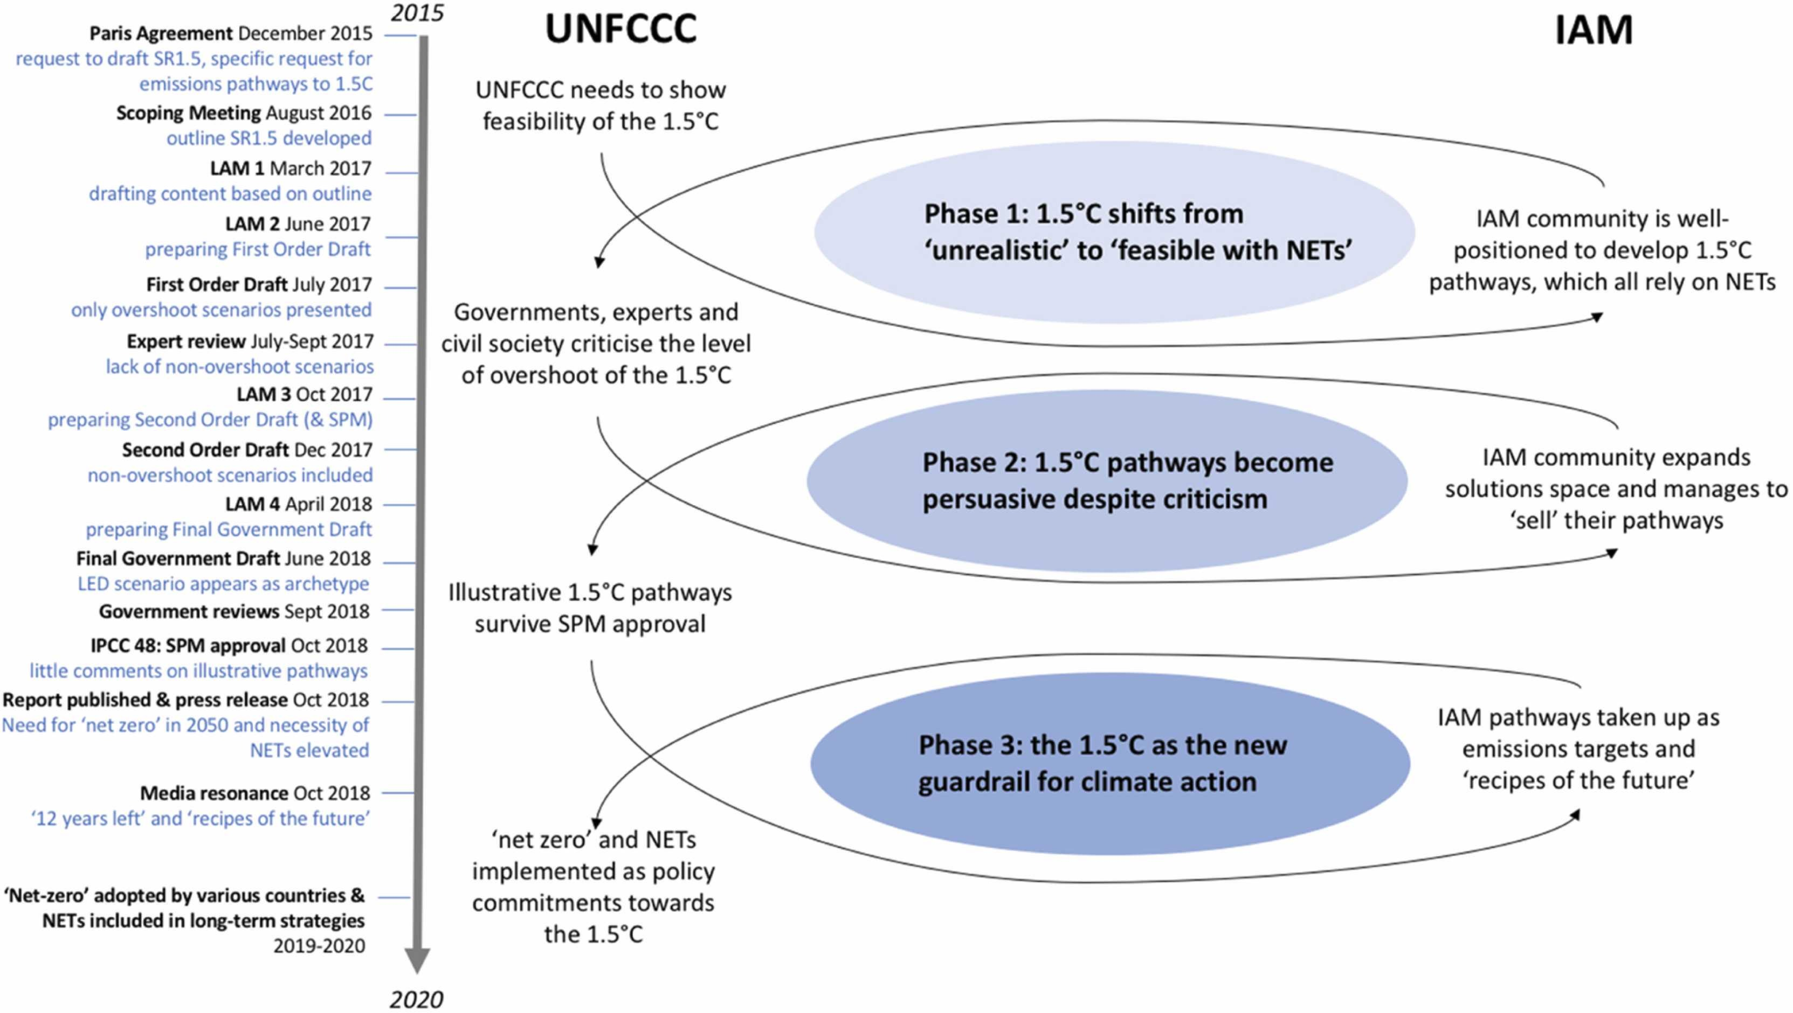
Climate Science and Policy Interaction
Climate policy questions have changed since the Paris Agreement from "Where do we go?" to "How do we get there?"
Climate policy goals are implemented in the model by changing parameters for available policy instruments or adjusting model parameters
Market imperfections, institutional barriers or dynamics of the informal sector are difficult to represent in models
Notes:
van Beek, L., Oomen, J., Hajer, M., Pelzer, P., & van Vuuren, D. (2022). Navigating the political: An analysis of political calibration of integrated assessment modelling in light of the 1.5 °C goal. Environmental Science & Policy, 133(March), 193–202. https://doi.org/10.1016/j.envsci.2022.03.024
Roelfsema, M., van Soest, H. L., den Elzen, M., de Coninck, H., Kuramochi, T., Harmsen, M., Dafnomilis, I., Höhne, N., & van Vuuren, D. P. (2022). Developing scenarios in the context of the Paris Agreement and application in the integrated assessment model IMAGE: A framework for bridging the policy-modelling divide. Environmental Science & Policy, 135(May), 104–116. https://doi.org/10.1016/j.envsci.2022.05.001

Slide 16
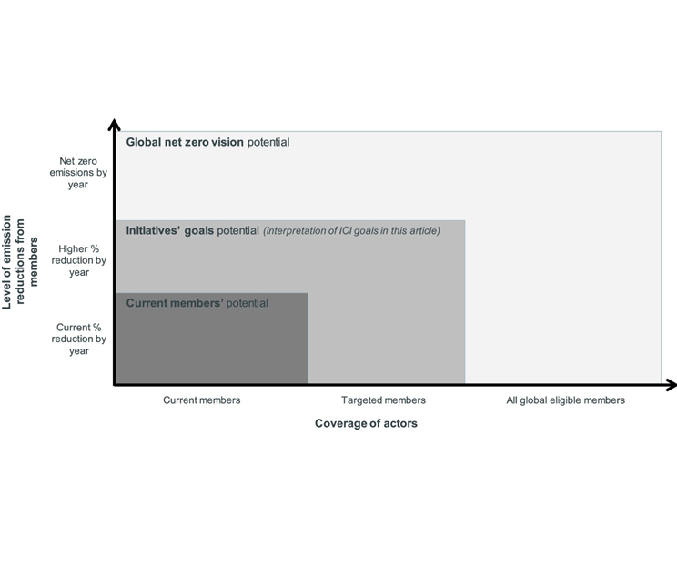
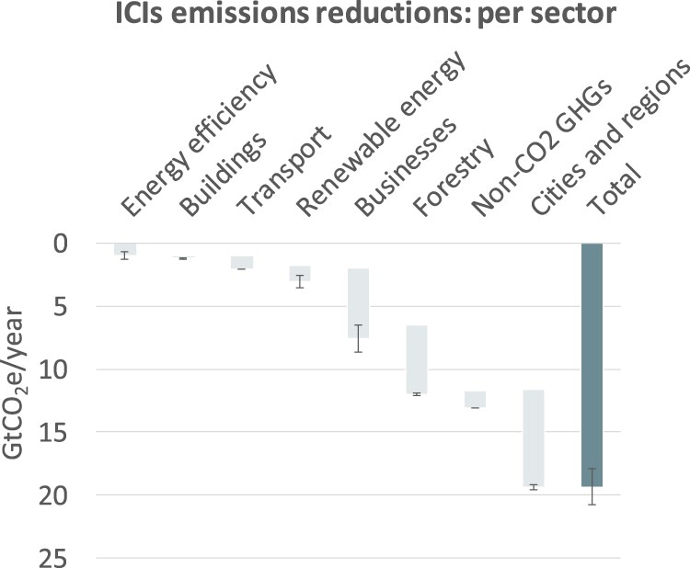
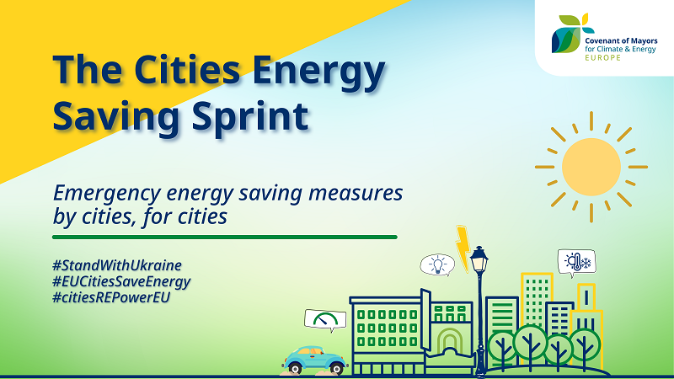
Energy Transition
International cooperative initiatives (ICIs) can be important vehicles for diffusion of knowledge and resources achieving further climate ambition
ICIs could play an important role in the decarbonization of the world’s largest emitters besides national policies
Collaboration is needed involving a diversity of institutions and stakeholders from different countries including state and non-state actors
Notes:
Lui, S., Kuramochi, T., Smit, S., Roelfsema, M., Hsu, A., Weinfurter, A., Chan, S., Hale, T., Fekete, H., Lütkehermöller, K., Jose de Villafranca Casas, M., Nascimento, L., Sterl, S., & Höhne, N. (2021). Correcting course: the emission reduction potential of international cooperative initiatives. Climate Policy, 21(2), 232–250. https://doi.org/10.1080/14693062.2020.1806021
https://www.eumayors.eu/plans-and-actions/cities-energy-saving-sprint.html

Slide 17

Modeling Tools
Simulation models simulate an energy-system based on specified equations and characteristics
Optimisation models optimise a given quantity based on energy scenarios
Equilibrium models take an economic approach and aim market clearance of all (general) or some (partial) markets
Increasing renewables in the energy system require better representation of short term variation in long-term energy models
Notes:
Ringkjøb, H.-K. K., Haugan, P. M., & Solbrekke, I. M. (2018). A review of modelling tools for energy and electricity systems with large shares of variable renewables. Renewable and Sustainable Energy Reviews, 96(July), 440–459. https://doi.org/10.1016/j.rser.2018.08.002

Slide 18
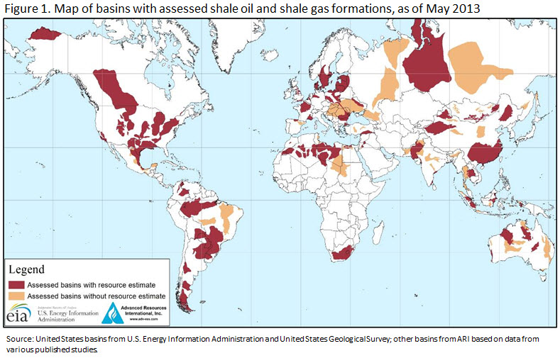
Limitations of Energy Modeling
Market prices do not reflect national security
Switching costs may not be fully known
Switching has usually happened between existing technologies/resources
Backstop technology adoption cannot happen overnight.
Natural resources can cross borders
International trade is not just trade
Oil is not just oil!
Notes:
Uğur Soytaş

Slide 19
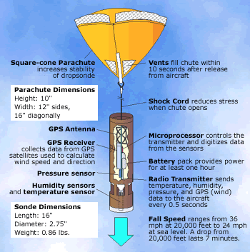
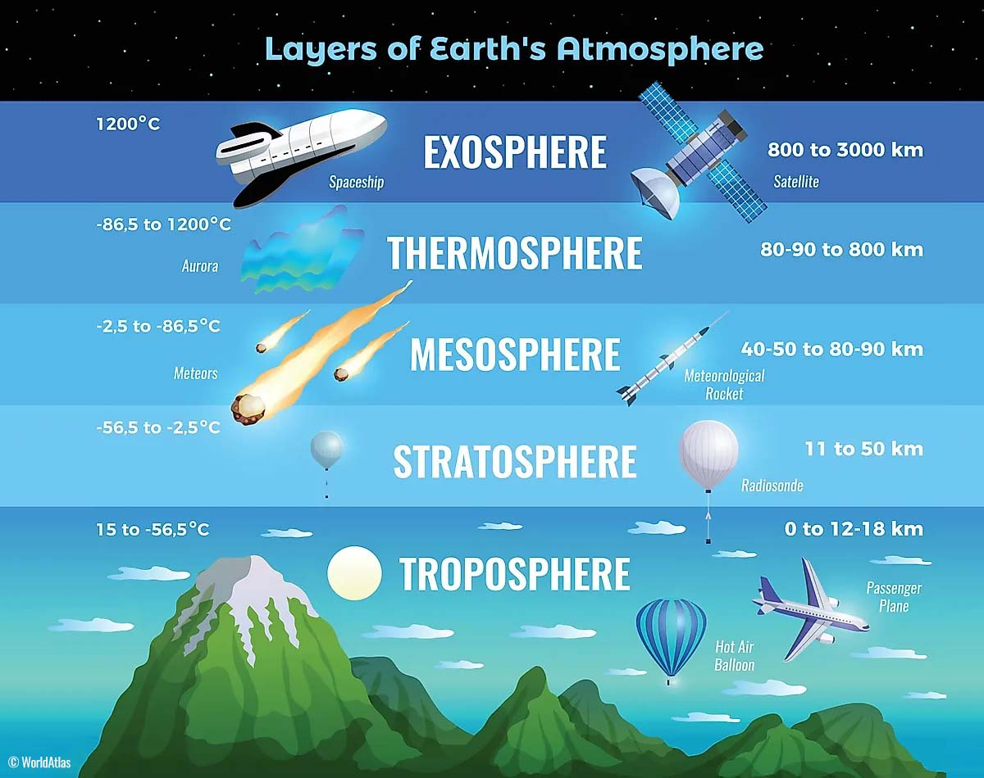
Model Scales
Climate Modeling is based on parametrization for defining the physical properties of the land-water-atmosphere interactions
Clouds
Boundary layer
Mountains
Radiation
Land-atmosphere coupling
Recent scientific findings show that mesoscale events could have larger influence in the climate system
Notes:
https://learnweather.com/basic-weather/atmosphere-where-do-thunderstorms-live-mk/
Stephan, C. C., Lane, T. P., & Jakob, C. (2020). Gravity Wave Influences On Mesoscale Divergence: An Observational Case Study. Geophysical Research Letters, 47(1). https://doi.org/10.1029/2019GL086539
https://doi.org/10.21036/LTPUB10825

Slide 20
References
[1] Mourik RM, Sonetti G, Robison RAV. The same old story – or not? How storytelling can support inclusive local energy policy. Energy Res Soc Sci [Internet]. 2021. 73(November 2020):101940.
[2] Sovacool BK, Martiskainen M, Hook A, Baker L. Beyond cost and carbon: The multidimensional co-benefits of low carbon transitions in Europe. Ecol Econ [Internet]. 2020. 169(August 2019):106529.
[3] Jones CD, Ciais P, Davis SJ, Friedlingstein P, Gasser T, Peters GP, et al. Simulating the Earth system response to negative emissions. Environ Res Lett [Internet]. 2016. 11(9):095012.
[4] Rogelj J, Fricko O, Meinshausen M, Krey V, Zilliacus JJJ, Riahi K. Understanding the origin of Paris Agreement emission uncertainties. Nat Commun [Internet]. 2017. 8(1):15748.
[5] Vinca A, Parkinson S, Byers E, Burek P, Khan Z, Krey V, et al. The NExus Solutions Tool (NEST) v1.0: an open platform for optimizing multi-scale energy–water–land system transformations. Geosci Model Dev [Internet]. 2020. 13(3):1095–121.
[6] Huppmann D, Gidden M, Fricko O, Kolp P, Orthofer C, Pimmer M, et al. The MESSAGE Integrated Assessment Model and the ix modeling platform (ixmp): An open framework for integrated and cross-cutting analysis of energy, climate, the environment, and sustainable development. Environ Model Softw [Internet]. 2019. 112(March 2018):143–56.
[7] Fischhoff B. Making behavioral science integral to climate science and action. Behav Public Policy [Internet]. 2020. :1–15.
[8] Nicholls Z, Meinshausen M, Lewis J, Smith CJ, Forster PM, Fuglestvedt JS, et al. Changes in IPCC Scenario Assessment Emulators Between SR1.5 and AR6 Unraveled. Geophys Res Lett [Internet]. 2022. 49(20):1–11.
[9] Kemp L, Xu C, Depledge J, Ebi KL, Gibbins G, Kohler TA, et al. Climate Endgame: Exploring catastrophic climate change scenarios. Proc Natl Acad Sci [Internet]. 2022. 119(34):1–9.
[10] Qiu Y, Lamers P, Daioglou V, McQueen N, de Boer H-S, Harmsen M, et al. Environmental trade-offs of direct air capture technologies in climate change mitigation toward 2100. Nat Commun [Internet]. 2022. 13(1):3635.
[11] van Beek L, Oomen J, Hajer M, Pelzer P, van Vuuren D. Navigating the political: An analysis of political calibration of integrated assessment modelling in light of the 1.5 °C goal. Environ Sci Policy [Internet]. 2022. 133(March):193–202.
[12] Roelfsema M, van Soest HL, den Elzen M, de Coninck H, Kuramochi T, Harmsen M, et al. Developing scenarios in the context of the Paris Agreement and application in the integrated assessment model IMAGE: A framework for bridging the policy-modelling divide. Environ Sci Policy [Internet]. 2022. 135(May):104–16.
[13] Lui S, Kuramochi T, Smit S, Roelfsema M, Hsu A, Weinfurter A, et al. Correcting course: the emission reduction potential of international cooperative initiatives. Clim Policy [Internet]. 2021. 21(2):232–50.
[14] Camarasa C, Mata É, Navarro JPJ, Reyna J, Bezerra P, Angelkorte GB, et al. A global comparison of building decarbonization scenarios by 2050 towards 1.5–2 °C targets. Nat Commun [Internet]. 2022. 13(1):3077.
[15] Ringkjøb H-KK, Haugan PM, Solbrekke IM. A review of modelling tools for energy and electricity systems with large shares of variable renewables. Renew Sustain Energy Rev [Internet]. 2018. 96(July):440–59.
[16] Stephan CC, Lane TP, Jakob C. Gravity Wave Influences On Mesoscale Divergence: An Observational Case Study. Geophys Res Lett [Internet]. 2020. 47(1).

